Slide 1

Statistical Analysis of School Shootings in the U.S.: Demographic & Economic Correlates Presented By : Rohith Reddy Patlolla , Shashidhar Ragula

Slide 2
Research Questions:
Is there a correlation between population density and school shootings?
Do unemployment rates correlate with the frequency of school shootings?
How does student enrollment distribution relate to school shootings?

Slide 3
Data Sources and Methodology
Data Sources:
Population density and demographic data for each state : https://fred.stlouisfed.org/searchresults/?st=us states population&t=population%3Busa%3Bstate&ob=sr&od=desc
Unemployment rates across U.S. states :https://www.bls.gov/charts/state-employment-and-unemployment/state-unemployment-rates-animated.htm
School shooting incidents by state :https://kaggle.com/code/ecodan/us-school-shootings-dataset
Total student enrollment figures: https://nces.ed.gov/ccd/elsi/tableGenerator.aspx?savedTableID=649123

Slide 4
Methodology
Data Collection:
School Shootings Data: Geographic data on incidents, including location, date, and specific details of each event.
Socioeconomic Data: Unemployment rates, population, and student enrollment statistics per state.
Data Cleaning and Preparation:
Standardization: Harmonized state names and filtered for relevant years.
Handling Missing Data: Addressed gaps in socioeconomic data to maintain accuracy.
Spatial Join:
Merged school shooting data with socioeconomic data by state using ArcGIS's spatial join to aggregate shooting incidents per state.

Slide 5
Buffer Analysis :
buffer analysis is used around schools to examine the socioeconomic factors within a defined radius of each school. This allowed me to analyze whether areas with higher unemployment rates and population density correlated with a higher frequency of school shootings within proximity to these institutions.
Spatial Analysis and Mapping:
Hotspot Analysis: Identified geographic clusters of high-incidence areas.
Visualization: Created choropleth maps and cluster analyses to highlight findings and interpret spatial patterns.

Slide 6
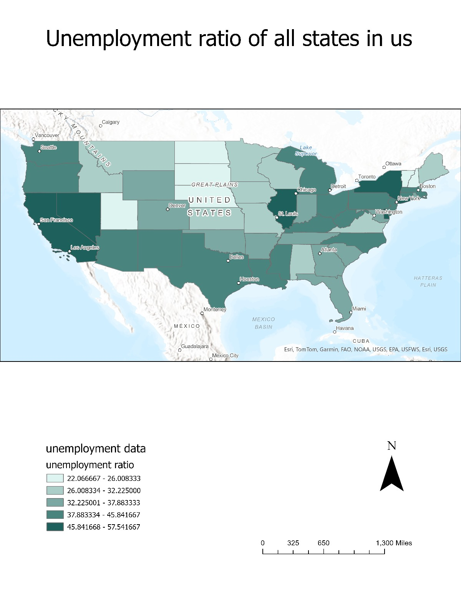
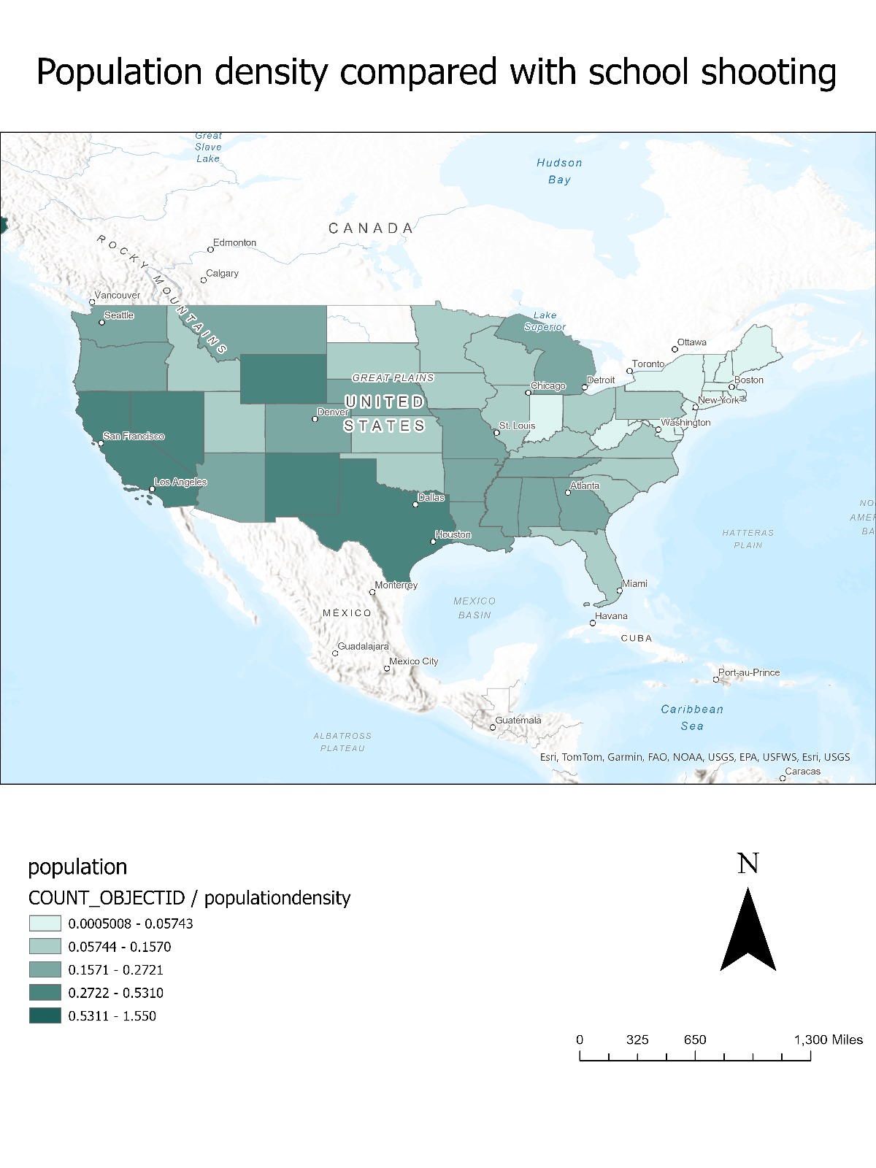
Population Density and School Shootings Unemployment Rates by State

Slide 7
Population Density and School Shootings
Key Observation: While some high-density areas have a notable number of incidents, density alone does not explain variations in school shootings, suggesting that other factors might be at play.
Unemployment Rates by State
Key Observation: Regions with higher unemployment rates may have socio-economic challenges, yet there is no strong, direct correlation with school shooting frequency based solely on this factor.

Slide 8
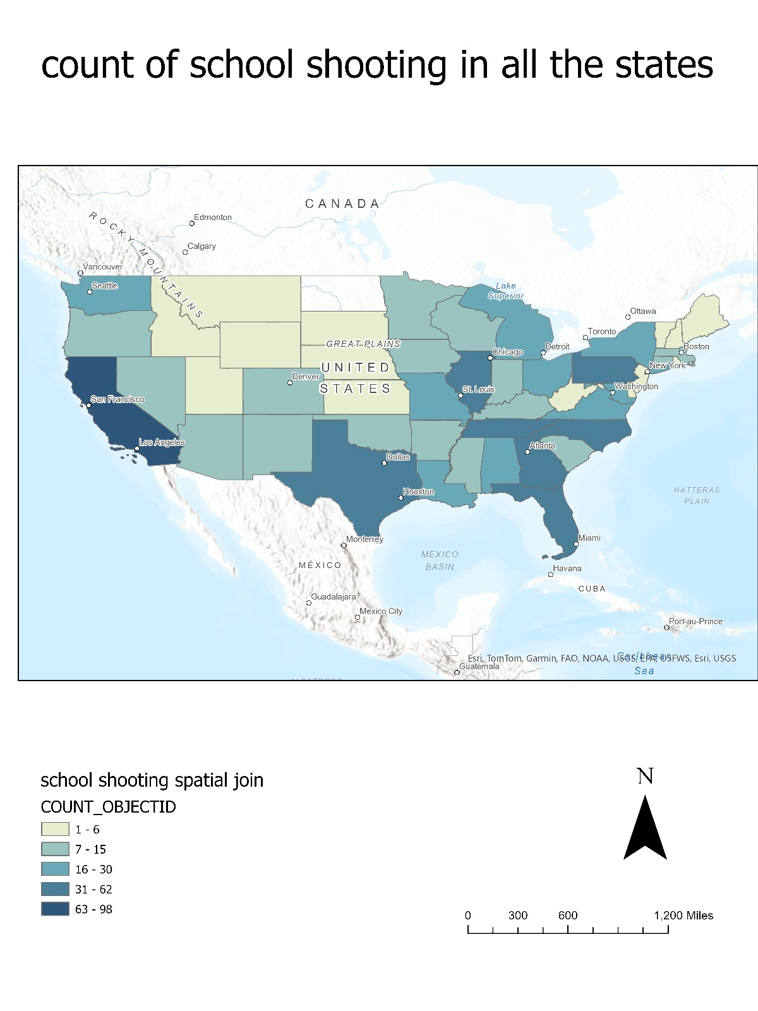
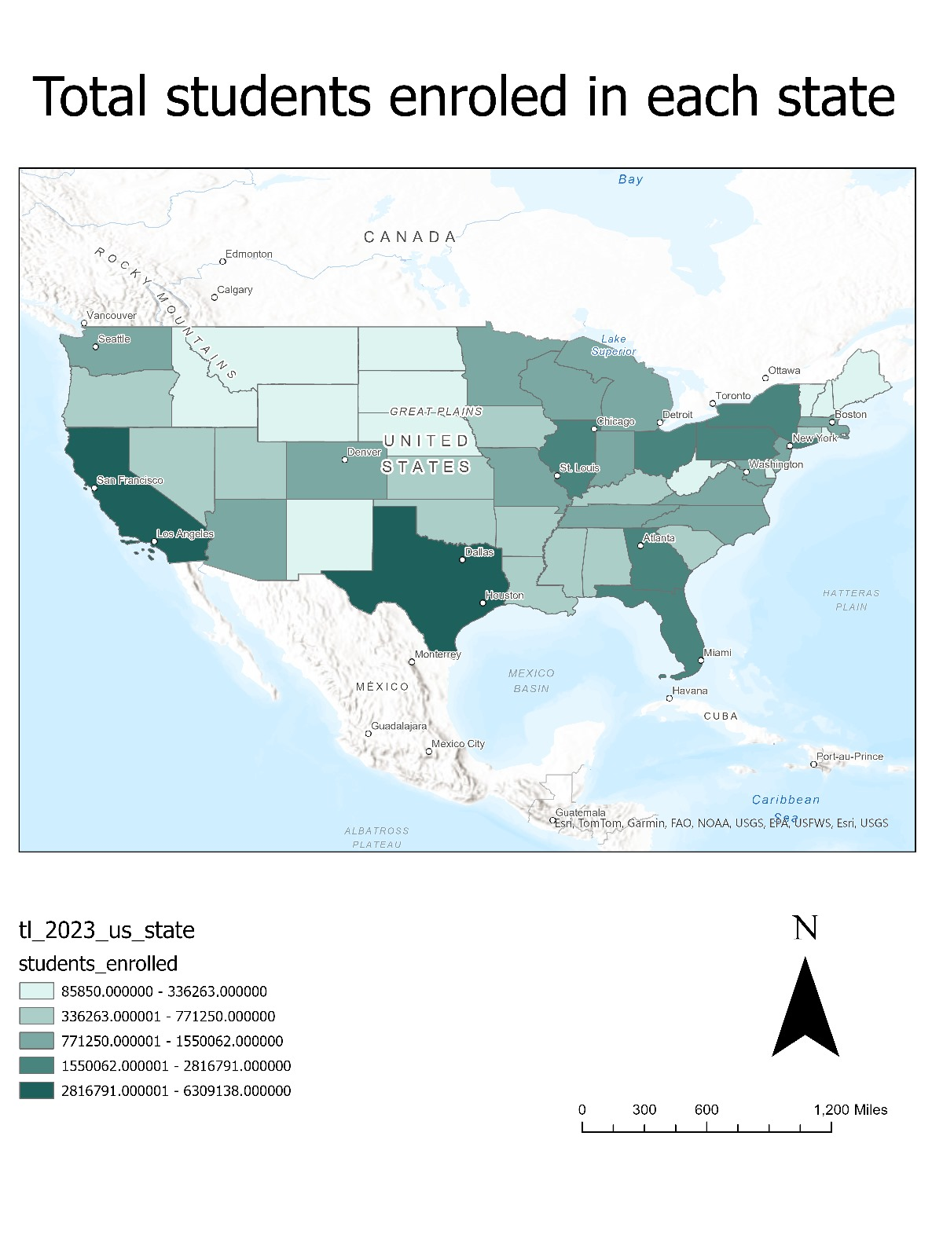
School Shooting count by State Student Enrollment by State

Slide 9
School Shooting Frequency by State
Key Observation: There are states with significantly higher counts of school shootings, prompting further investigation into additional influencing variables in these areas.
Student Enrollment by State
Key Observation: Although states with larger student populations might experience more school shootings, enrollment figures alone are not a strong predictor.

Slide 10
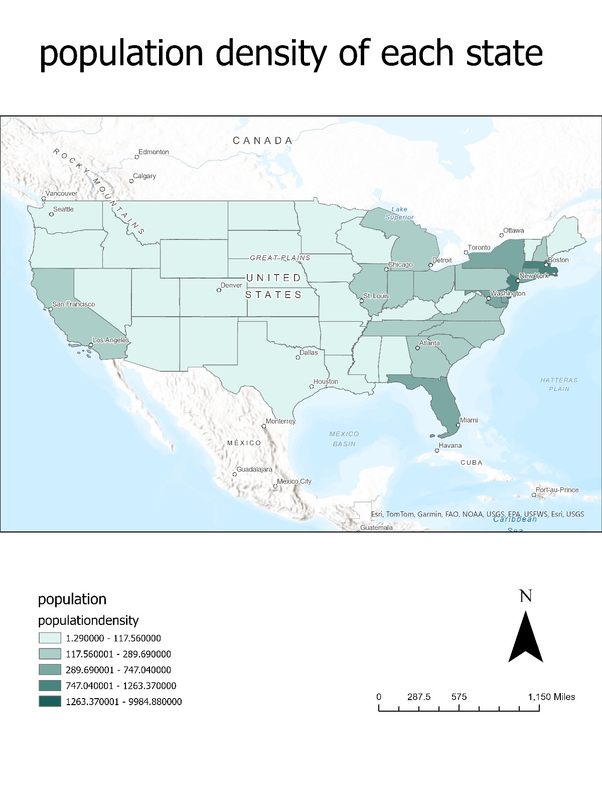
Population Density by State
Key Observation: High-density states exhibit varied school shooting frequencies, further supporting the hypothesis that multiple factors influence school shootings rather than density alone.

Slide 11
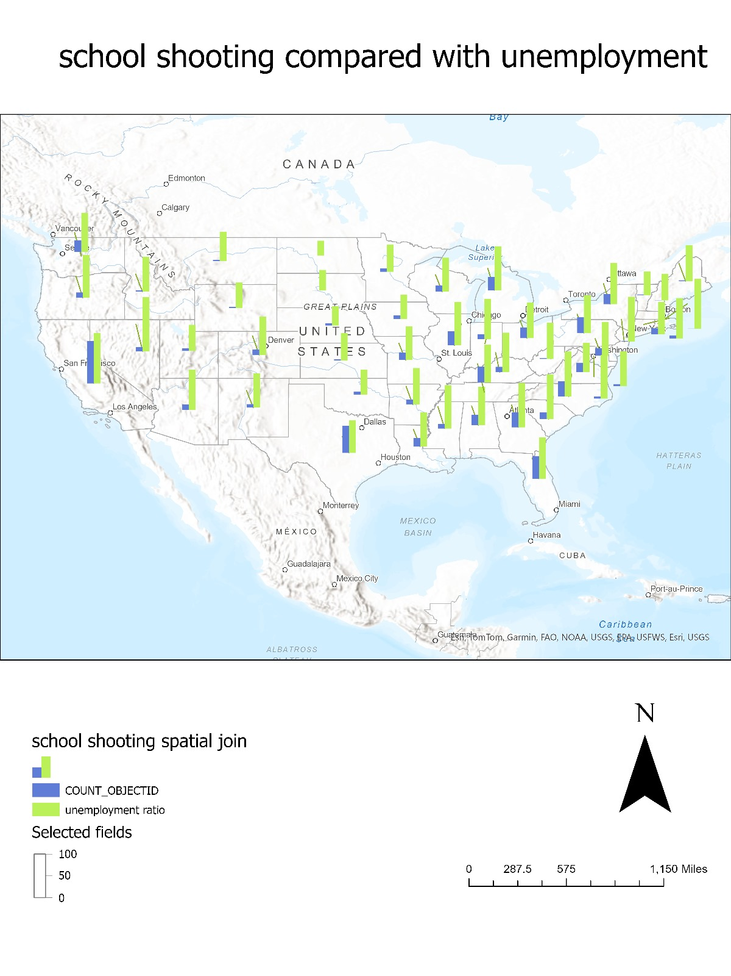
Combined Analysis: School Shootings and Unemployment Rates
Key Observation: Certain states show both high unemployment and higher school shooting rates; however, this combination varies, indicating that unemployment alone is not a definitive predictor but may be one of several influencing factors.

Slide 12
comparing school shooting and student enrollment
Key Observation:
This map compares the frequency of school shootings to student enrollment numbers across U.S. states. While states with higher student enrollment might be expected to have more school shooting incidents proportionally, the data reveals that this is not a straightforward correlation.

Slide 13
Conclusion and Findings
Conclusion:
No single factor—whether population density, unemployment rate, or student enrollment—is a strong predictor of school shootings.
Certain states with higher unemployment or population density show increased incidents, but the correlation is not consistent across the U.S.
A multi-faceted approach is required to understand the underlying causes of school shootings, potentially involving additional variables like socio-economic stress, mental health resources, and community factors.
Implications for Further Research: Future studies could incorporate more granular data, including mental health access, social support systems, and gun control measures, to gain a deeper understanding of contributing factors.

